Slide 1
Importing CSV
Make sure all currency values are in Pounds (£) to two decimal places. All dates to appear in the medium format: DD/MM/YYYY Using a suitable database package, import the file GymMembers.CSV Use appropriate data types Set the Member_Number as the key field.
Import the file Branches.CSV as a new table in your database. Use appropriate data types Set the Branch_Name as the key field.
Import the file PersonalTrainer.CSV as a new table in your database. Use appropriate data types Set the TrainerID as the key field.
Create the appropriate one to many relationship using the key fields: Identify the primary and foreign keys which will be used.

Slide 2
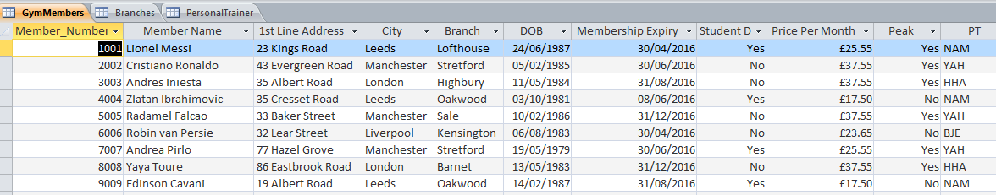
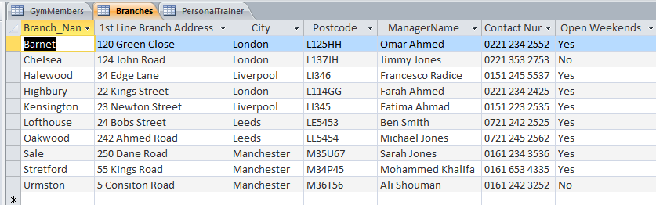
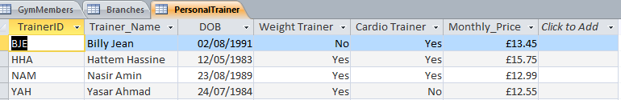

Slide 3
Query and Report
Produce a report which: Contains a new field called New_Price which is calculated at run-time. £2.50 needs to be added the Price Per Month field. Shows only the records where: Branch in not Streford Leeds or Manchester Membership expires between April and June 2016 Student Discount is Given Yasar Ahmad is not the personal trainer. Shows only the fields Member Name, City, Branch, Membership Expiry, New_Price in this order. Fits on a single page wide and has page orientation of Landscape. Sorts the data into ascending order of Member Name and New_Price. Calculates the average of the New_Price field. Include an appropriate label and place it at the bottom of the report. Includes the heading Updated Price at the top of the page Has your name on the right in the report header.

Slide 4
Query and Report
Produce a report which: Contains a new field called Final_Price which is calculated at run-time. Yasar Ahmad personal training fee of £12.55 needs to be added to the Monthly_Price. Shows only the records where: Address which contains Street. Excludes Oakwood and Lofthouse Branches. Membership expires between April and August 2016 Student Discount is not given. Shows only the fields Member Name, Trainer_Name, Branch, Membership Expiry, Final_Price in this order. Fits on a single page wide and has page orientation of Landscape. Sorts the data into ascending order of Branch and Membership Expiry. Calculates the number of members. Include an appropriate label and place it at the bottom of the report. Includes the heading Updated Trainer Prices at the top of the page Has your name on the right in the page header.

